Slide 1
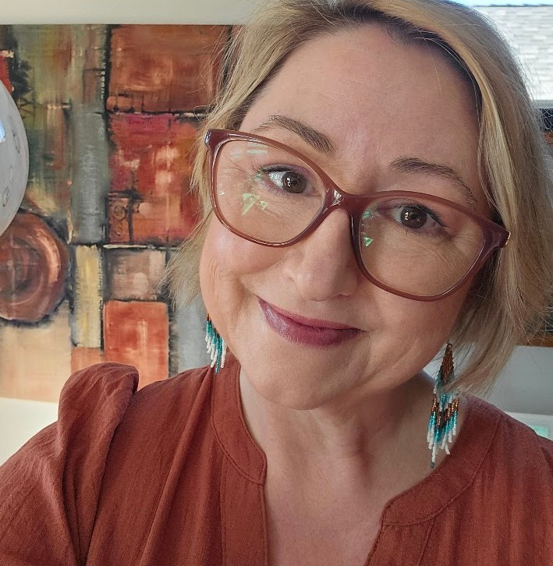

SIDE A: PRACTICAL
"IKIGAI APPROACH TO JOB SEARCH"
Pre-Work & Handbook
Presented by Katherine Eriksen, CPHR Founder, Cat & Mouse Recruitment

Slide 2
What is Ikigai?
Ikigai is a Japanese concept often translated as “a reason for being”. It sits at the intersection of:
What you love
What you are good at
What you can be paid for or rewarded for What the world needs

Slide 3
Pre-Workshop Reflection
Section A
What do you love? Activities that energize me
What activities make you lose track of time?
Take 20-30 minutes to reflect honestly. There are no right or wrong answers.
Write quickly and openly - patterns often emerge later.
Things I naturally gravitate toward
What topics, hobbies, conversations, or experiences consistently pull your attention?

Slide 4
Pre-Workshop Reflection
Moments When I Felt Most Alive
Describe 2-3 moments in life when you felt deeply fulfilled or joyful.
Take 20-30 minutes to reflect honestly. There are no right or wrong answers.
Write quickly and openly - patterns often emerge later.
People Often Associate Me With....
What do people say you are passionate about?

Slide 5
Section B:
Achievements I’m Proud Of
What Are You Good At?
Skills I Feel Confident Using
List practical, interpersonal, creative, or leadership skills.
My Natural Strengths:
Check any that apply: Listening Organizing Teaching
Creating Problem-solving
Encouraging others Strategic thinking Leadership
Building relationships Writing
Speaking Technical skills Caring for others Learning quickly Adaptability
Things People Ask Me For Help With

Slide 6
Section C:
What Does the World Need?
Problems I Care About
What issues frustrate or concern you?
If I could Improve One Thing in the World
Causes or Communities I Care About
Ways I Enjoy Helping Others

Slide 7
Section D:
What Can You Be Rewarded For?
Work or Contributions Others Value
What People Would Likely Pay Me For
Opportunities I’d like to Explore
Coaching Teaching
Entrepreneurship/side hustle Creative work
Community leadership Consulting Wellness/support work Skilled trades Writing/speaking Other
Experiences Where I Felt Useful and Appreciated

Slide 8

You are ready to participate in the Ikigai Workshop - you can complete Part 2 and 3 in the Workshop

Slide 9
Part 2: Identifying Patterns Reflection Questions
What themes or repeated words appeared in your answers? Where do your interests and skills overlap?
What strengths connect with what you care about?
What surprised you?

Slide 10
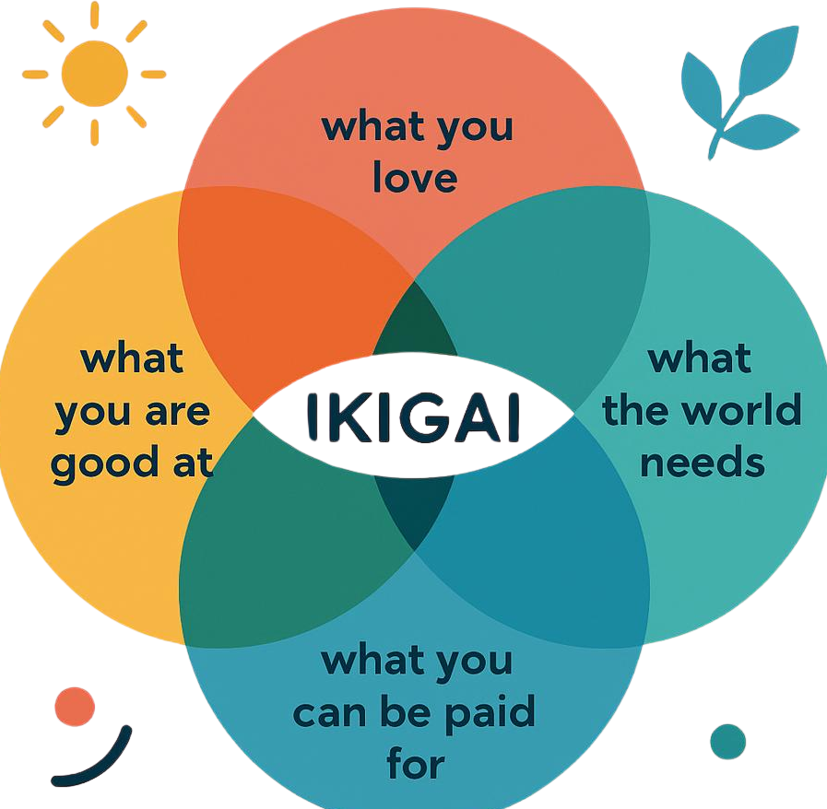

Part 3: Your Ikigai Map
Instructions:
In each circle, write key words or phrases.

Slide 11
Part 3: Your Ikigai Map
Overlap Reflections Passion
(What you love + what you are good at)
Profession
(What you are good at + what you can be rewarded for)
Mission
(What you love + what the world needs)
Vocation
(What the world needs + what you can be rewarded for)

Slide 12
My Emerging Ikigai
What feels like the strongest intersection of all four areas?
A Small Step I Can Take in the Next 30 Days

Slide 13

Thank you! I hope you enjoyed this workshop!
Connect with me:
www.linkedin.com/in/katherinecatandmouse
www.catandmouserecruitment.ca
katherine@catandmouserecruitment.ca
403-437-0472

